Slide 1
Linear Models for Supervised Learning
CISC7202 Tools for Machine Learning
(E11-G015, Wednesday 7-10pm)
Prof. Weijia Jia (賈維嘉) E11-4007
Office hour: Wed. 2—4pm, E11-4007; Thu. 7:30—9pm N21-1012a
Email: jiawj@umac.mo
Spring Semester, 2020

Slide 2
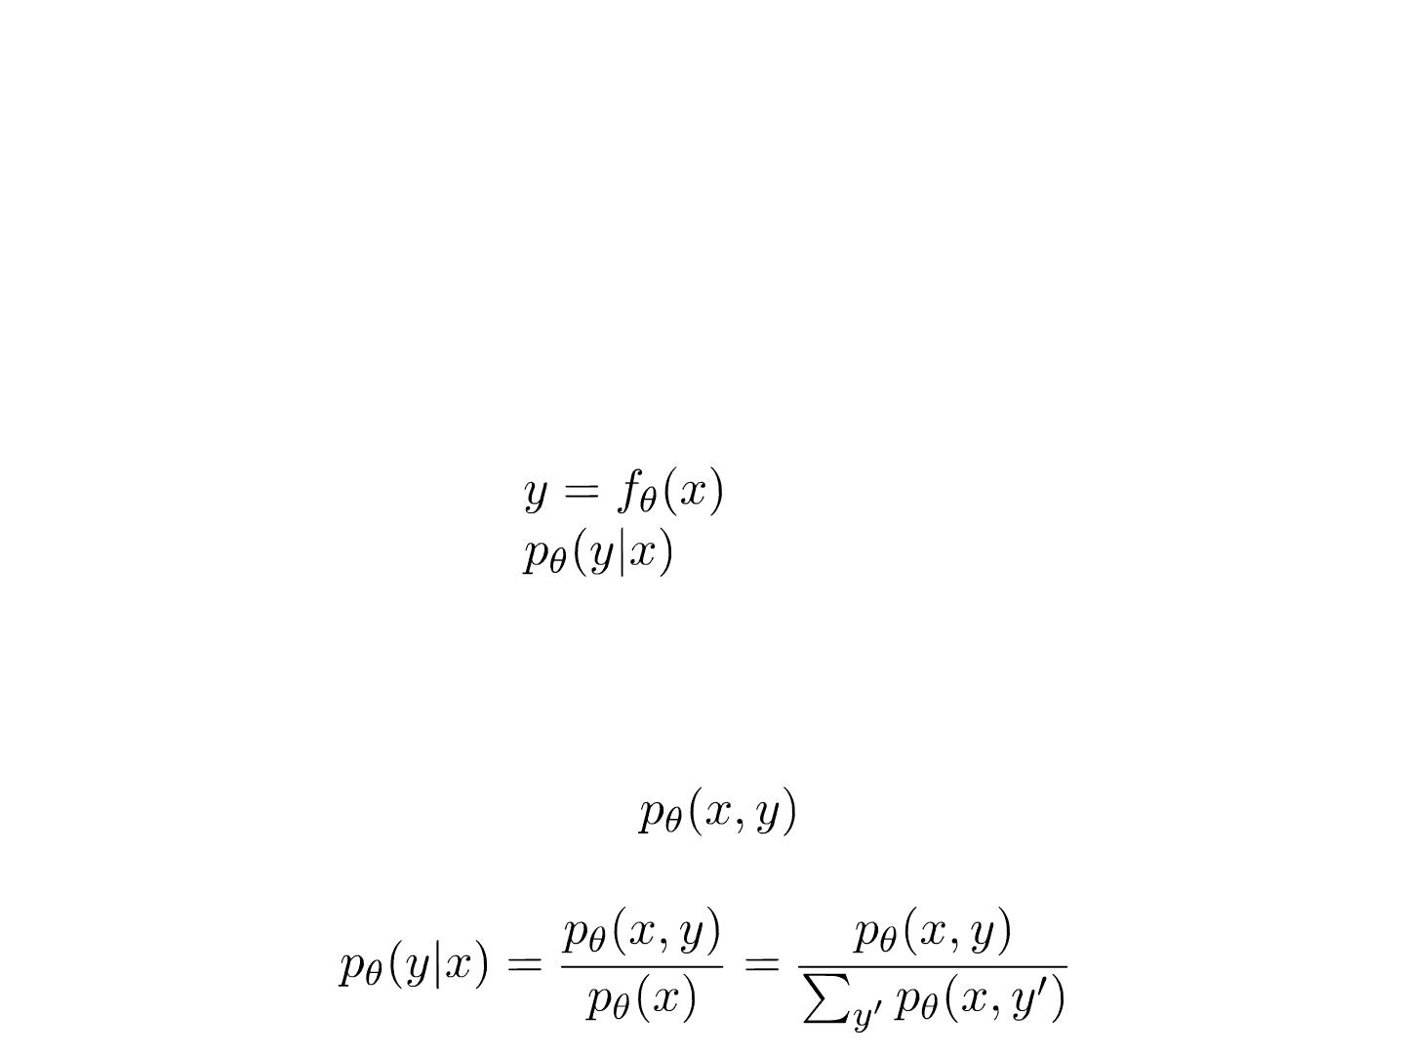
Discriminative Model and Generative Model
• Discriminative model
• modeling the dependence of unobserved variables on
observed ones
• also called conditional models.
• Deterministic:
• Probabilistic:
• Generative model
• modeling the joint probabilistic distribution of data given some hidden parameters or variables
• then do the conditional inference
Partial Slides Credits to Dr. Zhang Weinan @shanghai jiaotong Univ.

Slide 3
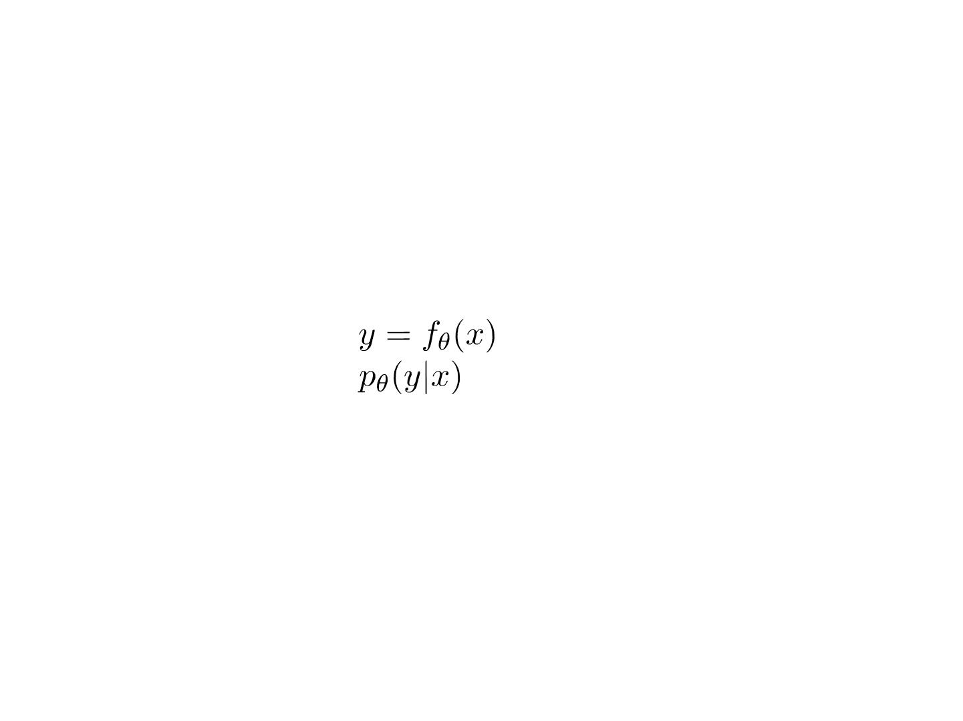
Discriminative Model and Generative Model
• Discriminative model
• modeling the dependence of unobserved variables on
observed ones
• also called conditional models.
• Deterministic:
• Probabilistic:
• Directly model the dependence for label prediction
• Easy to define dependence specific features and models
• Practically yielding higher prediction performance
• Linear regression, logistic regression, k nearest neighbor, SVMs,
(multi-layer) perceptrons, decision trees, random forest etc.

Slide 4
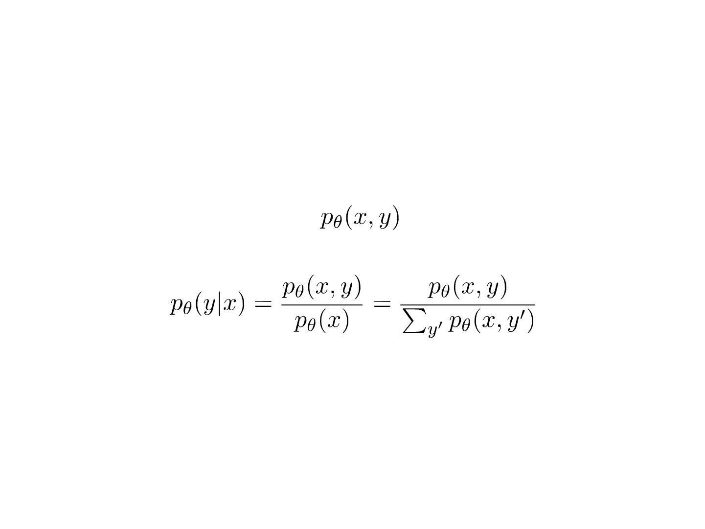
Discriminative Model and Generative Model
• Generative model
• modeling the joint probabilistic distribution of data
• given some hidden parameters or variables
• then do the conditional inference
• Recover the data distribution [essence of data science]
• Benefit from hidden variables modeling
• Naive Bayes, Hidden Markov Model, Mixture Gaussian, Markov
Random Fields, Latent Dirichlet Allocation etc.

Slide 5

Linear Regression

Slide 6
Linear Discriminative Models
• Discriminative model
• modeling the dependence of unobserved variables on
observed ones
• also called conditional models.
• Deterministic:
• Probabilistic:
• Focus of this course
• Linear regression model
• Linear classification model

Slide 7
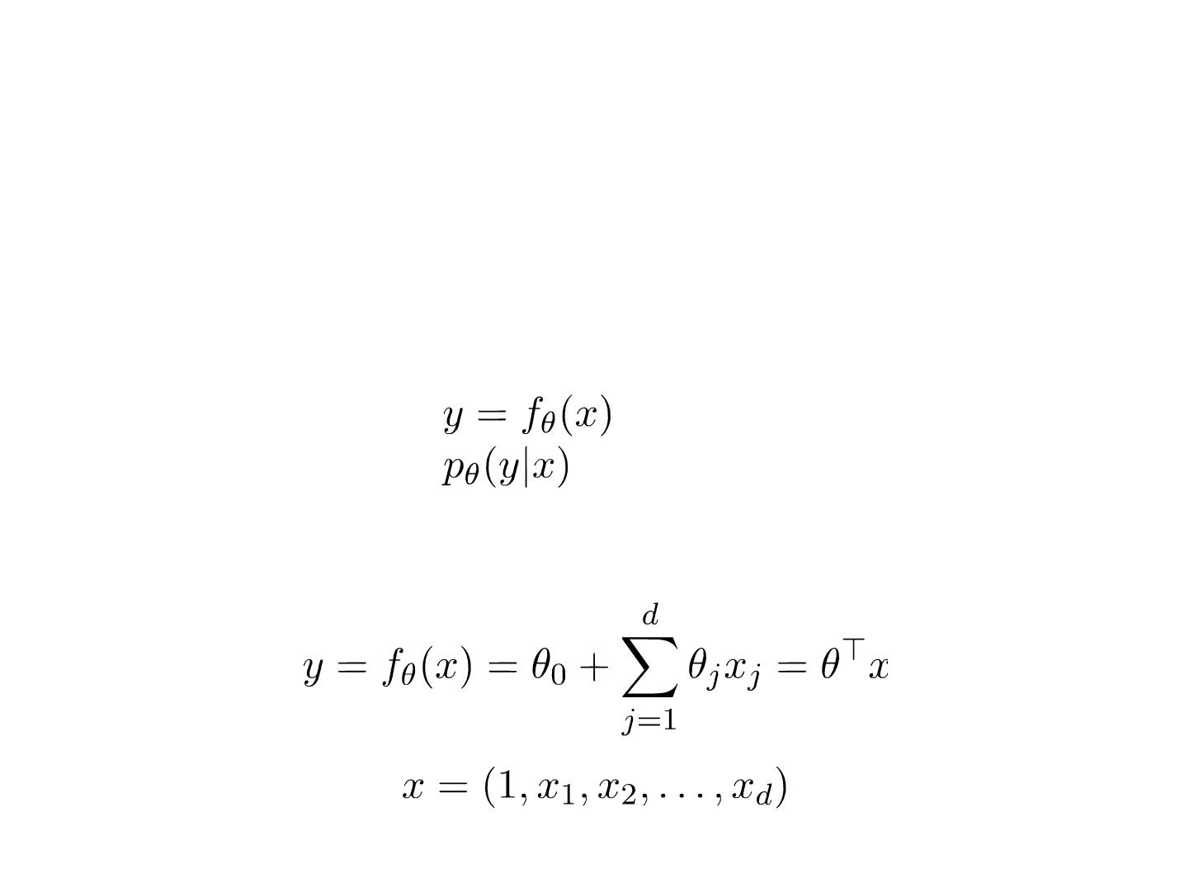
Linear Discriminative Models
• Discriminative model
• modeling the dependence of unobserved variables on
observed ones
• also called conditional models.
• Deterministic:
• Probabilistic:
• Linear regression model

Slide 8
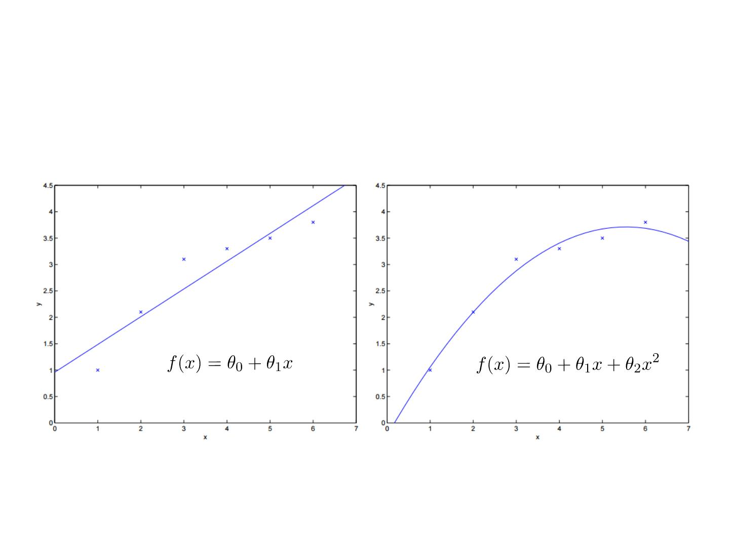
Linear Regression
• One-dimensional linear & quadratic regression
Linear Regression
Quadratic Regression
(A kind of generalized
linear model)

Slide 9
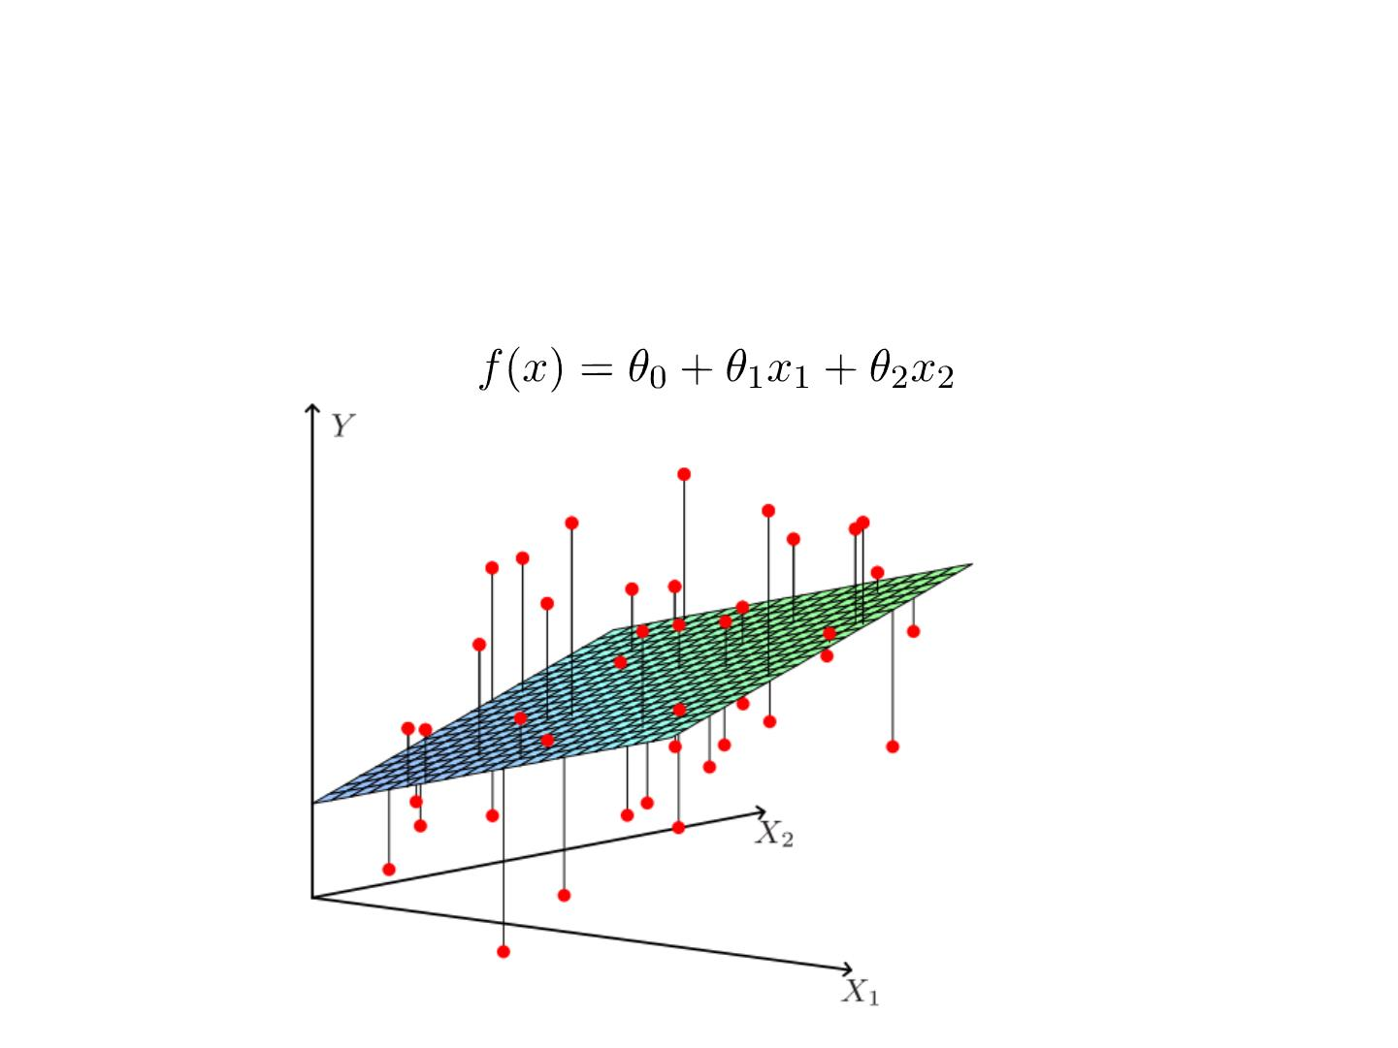
Linear Regression
• Two-dimensional linear regression

Slide 10
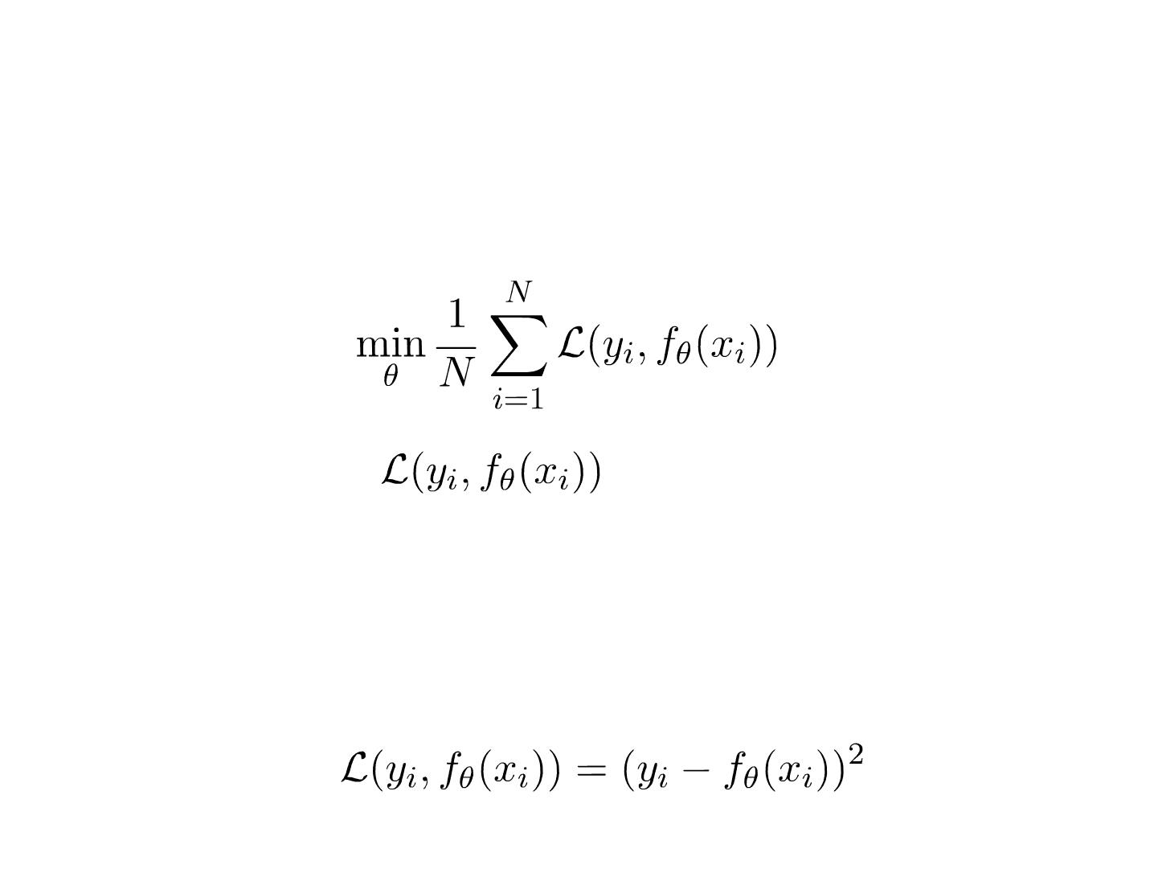
Learning Objective
• Make the prediction close to the corresponding
label
• Loss function
measures the error
between the label and prediction
• The definition of loss function depends on the data
and task
• Most popular loss function: squared loss

Slide 11
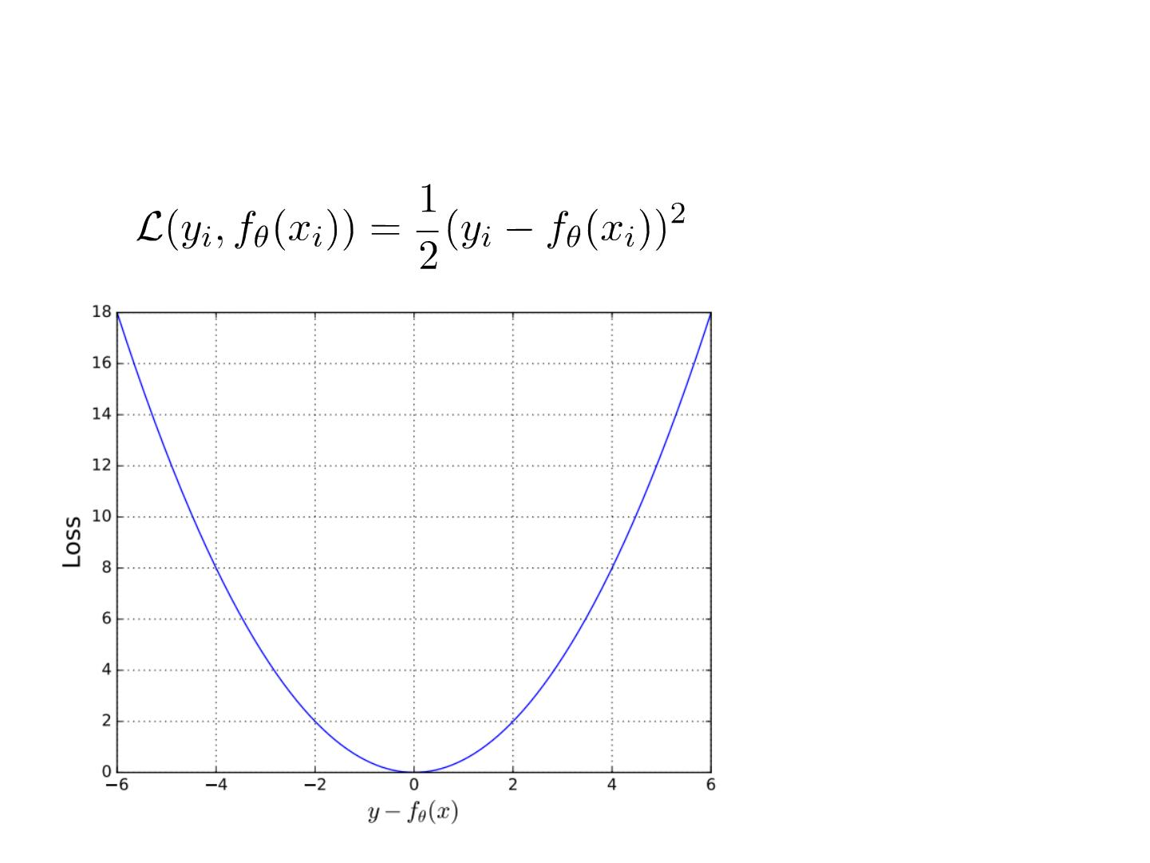
Squared Loss
• Penalty much
more on larger
distances
• Accept small
distance (error)
• Observation
noise etc.
• Generalization

Slide 12
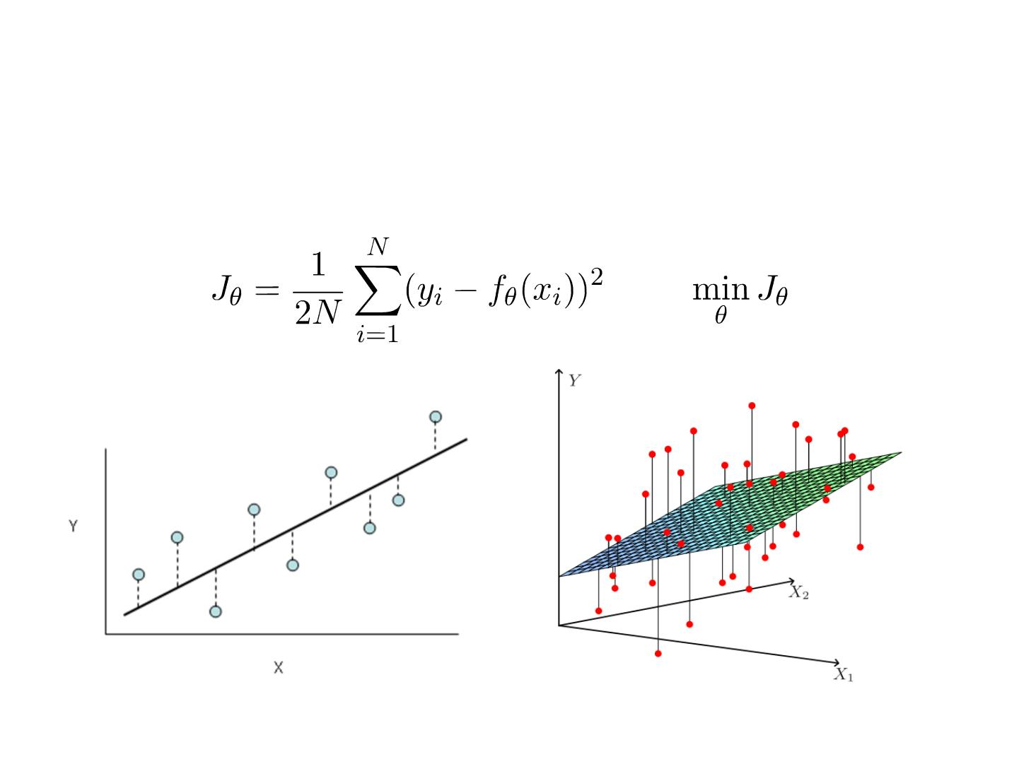
Least Square Linear Regression
• Objective function to minimize

Slide 13
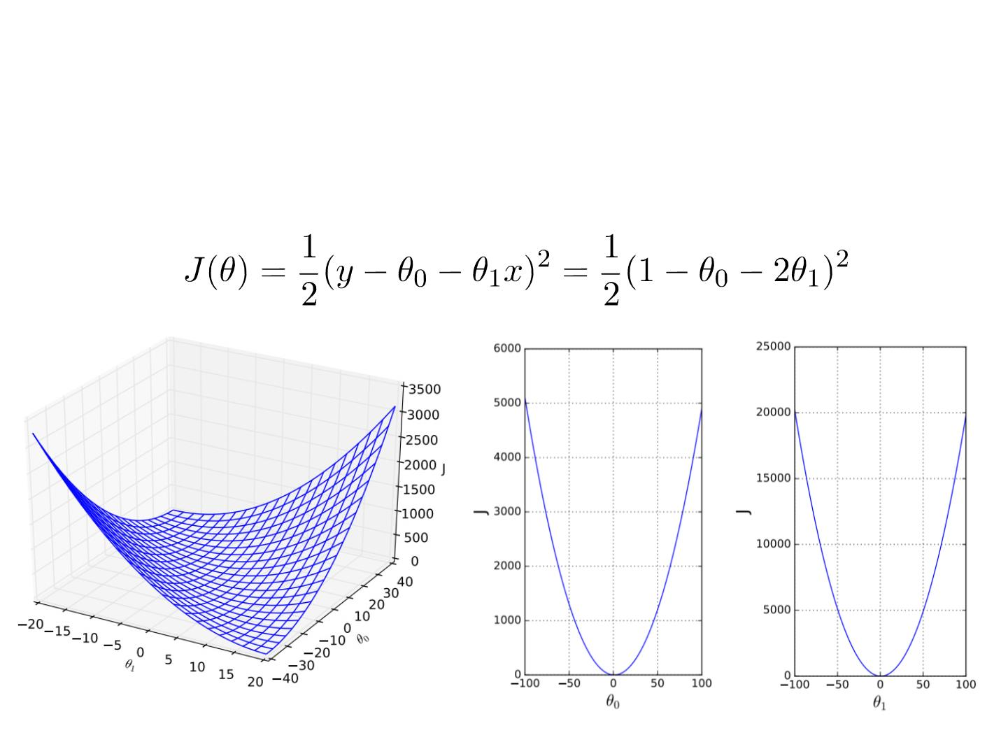
Minimize the Objective Function
• Let N=1 for a simple case, for (x,y)=(2,1)

Slide 14
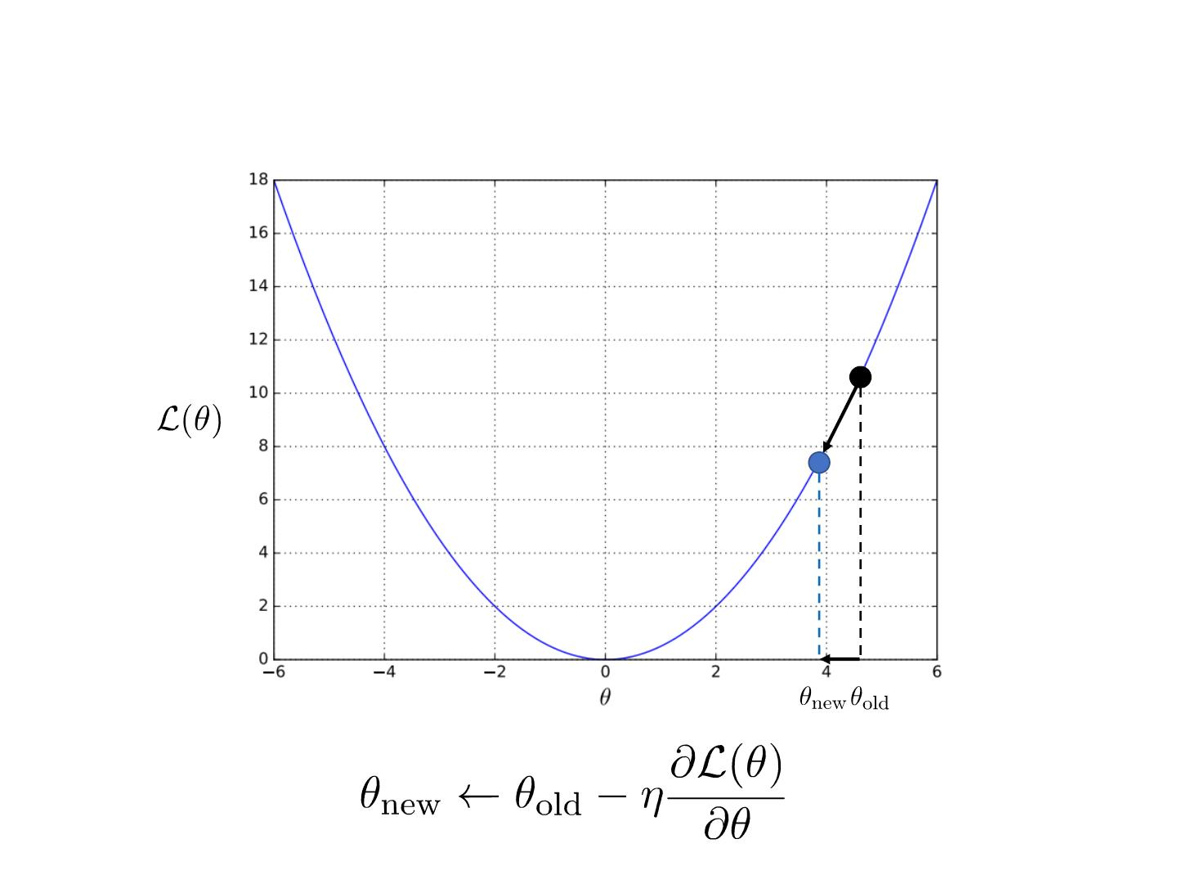
Gradient Learning Methods

Slide 15
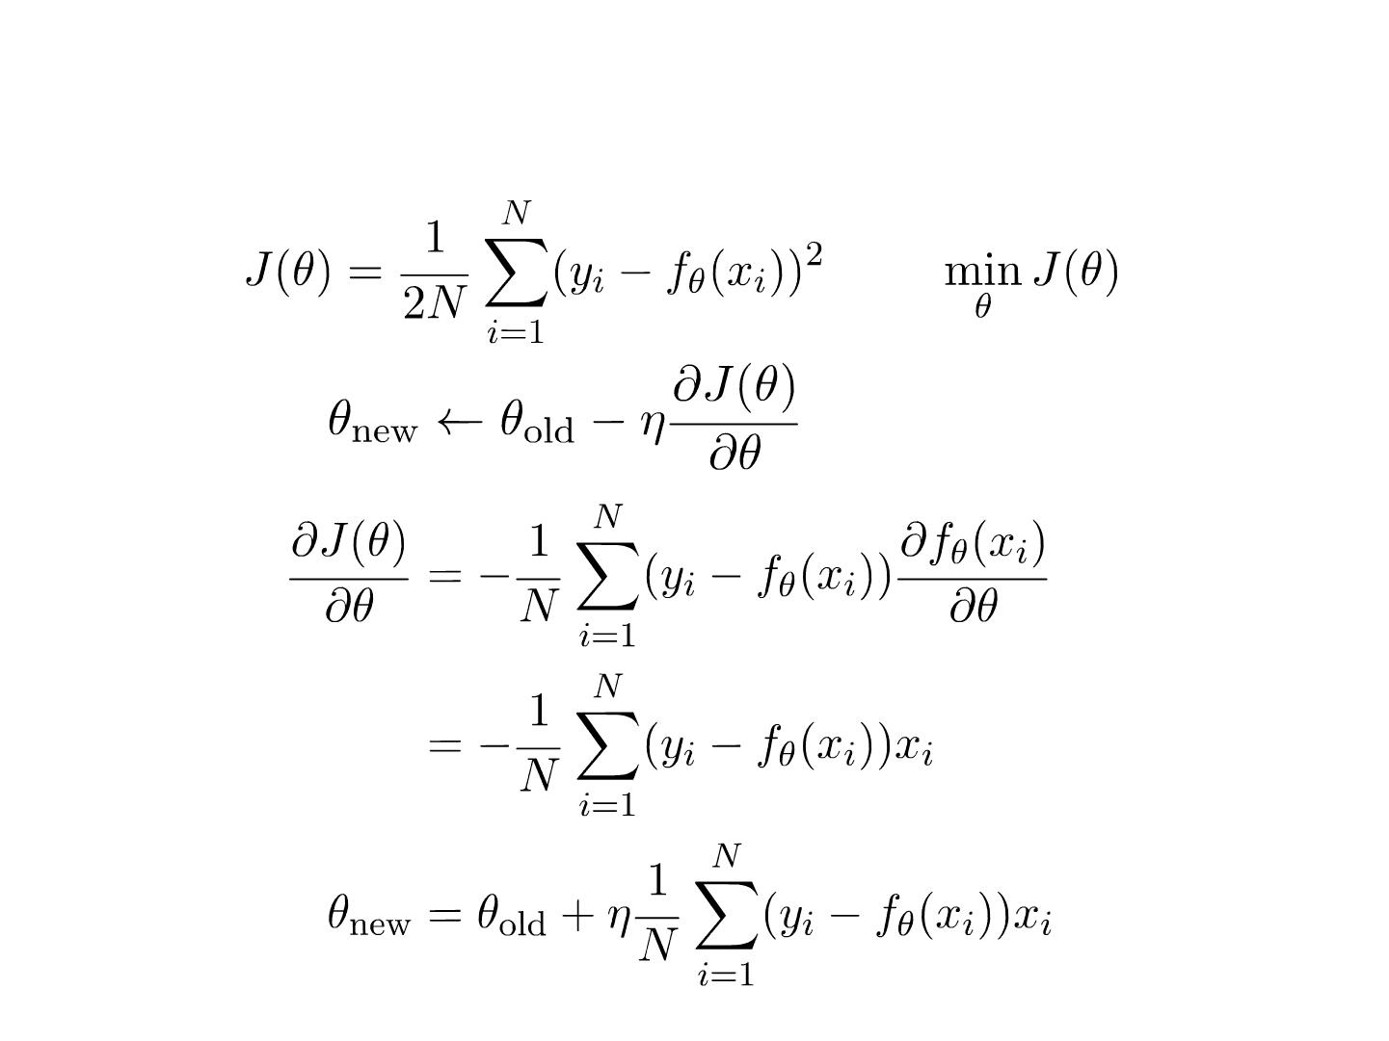
Batch Gradient Descent
• Update
for the whole batch

Slide 16
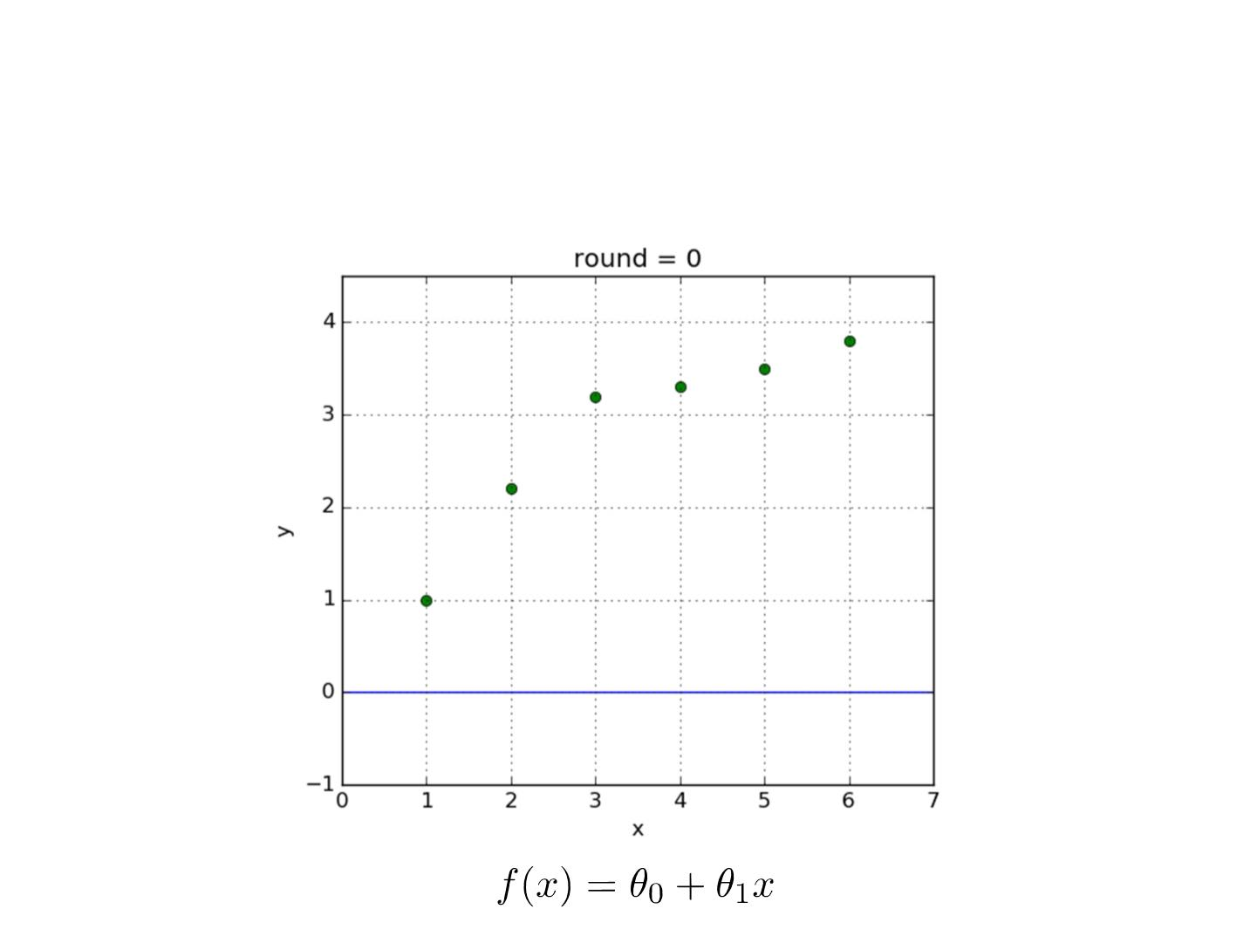
Learning Linear Model - Curve

Slide 17
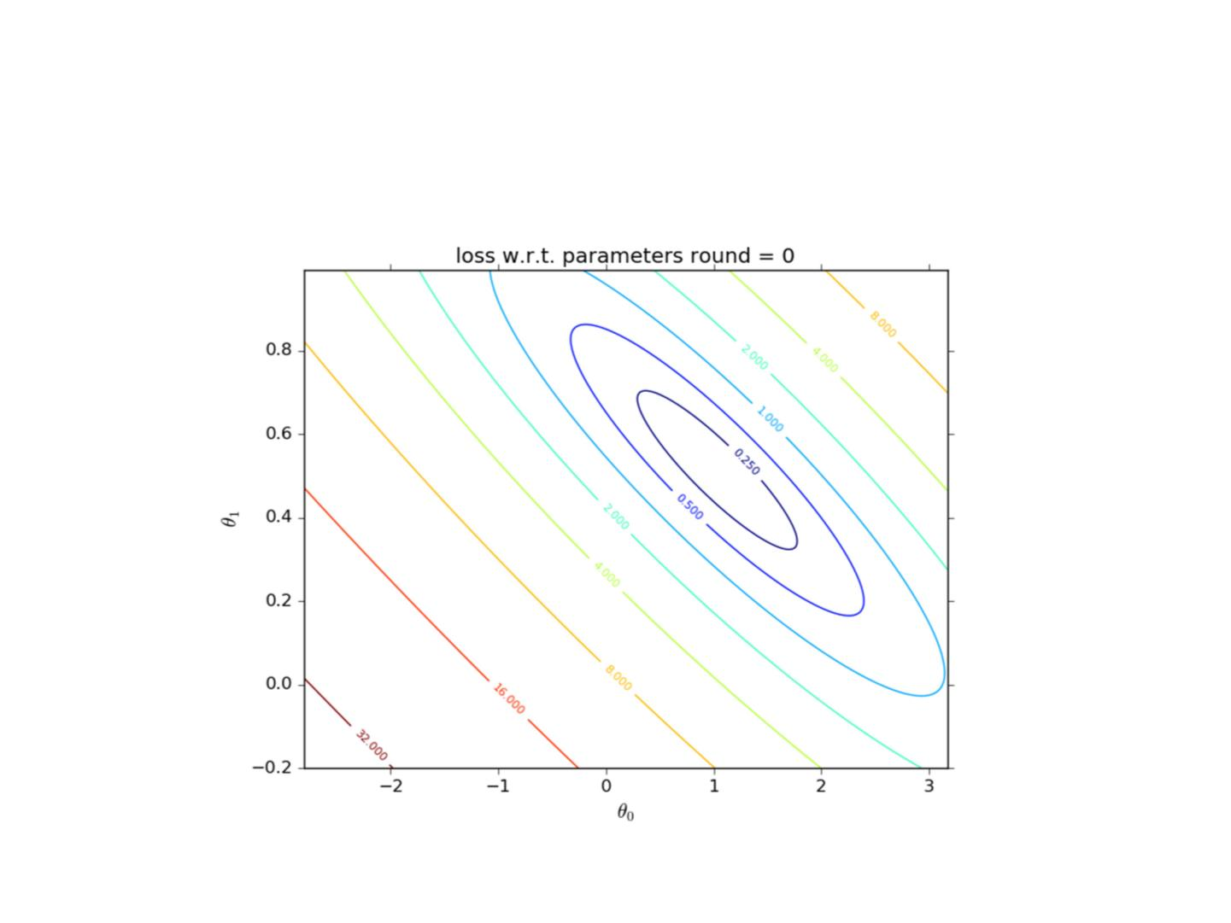
Learning Linear Model - Weights

Slide 18
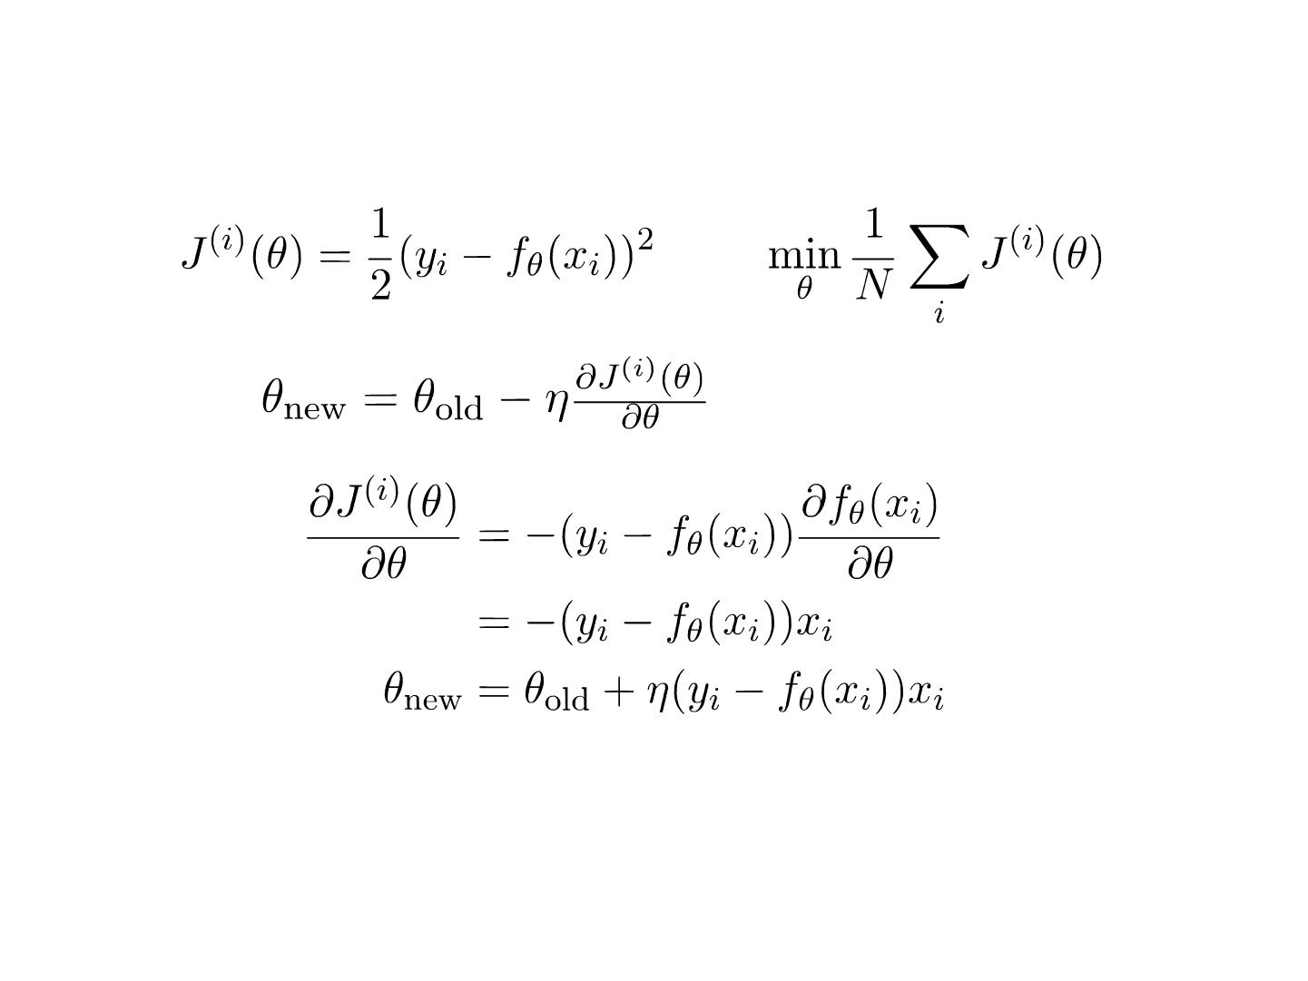
Stochastic Gradient Descent
• Update
for every single instance
• Compare with BGD
• Faster learning
• Uncertainty or fluctuation in learning

Slide 19
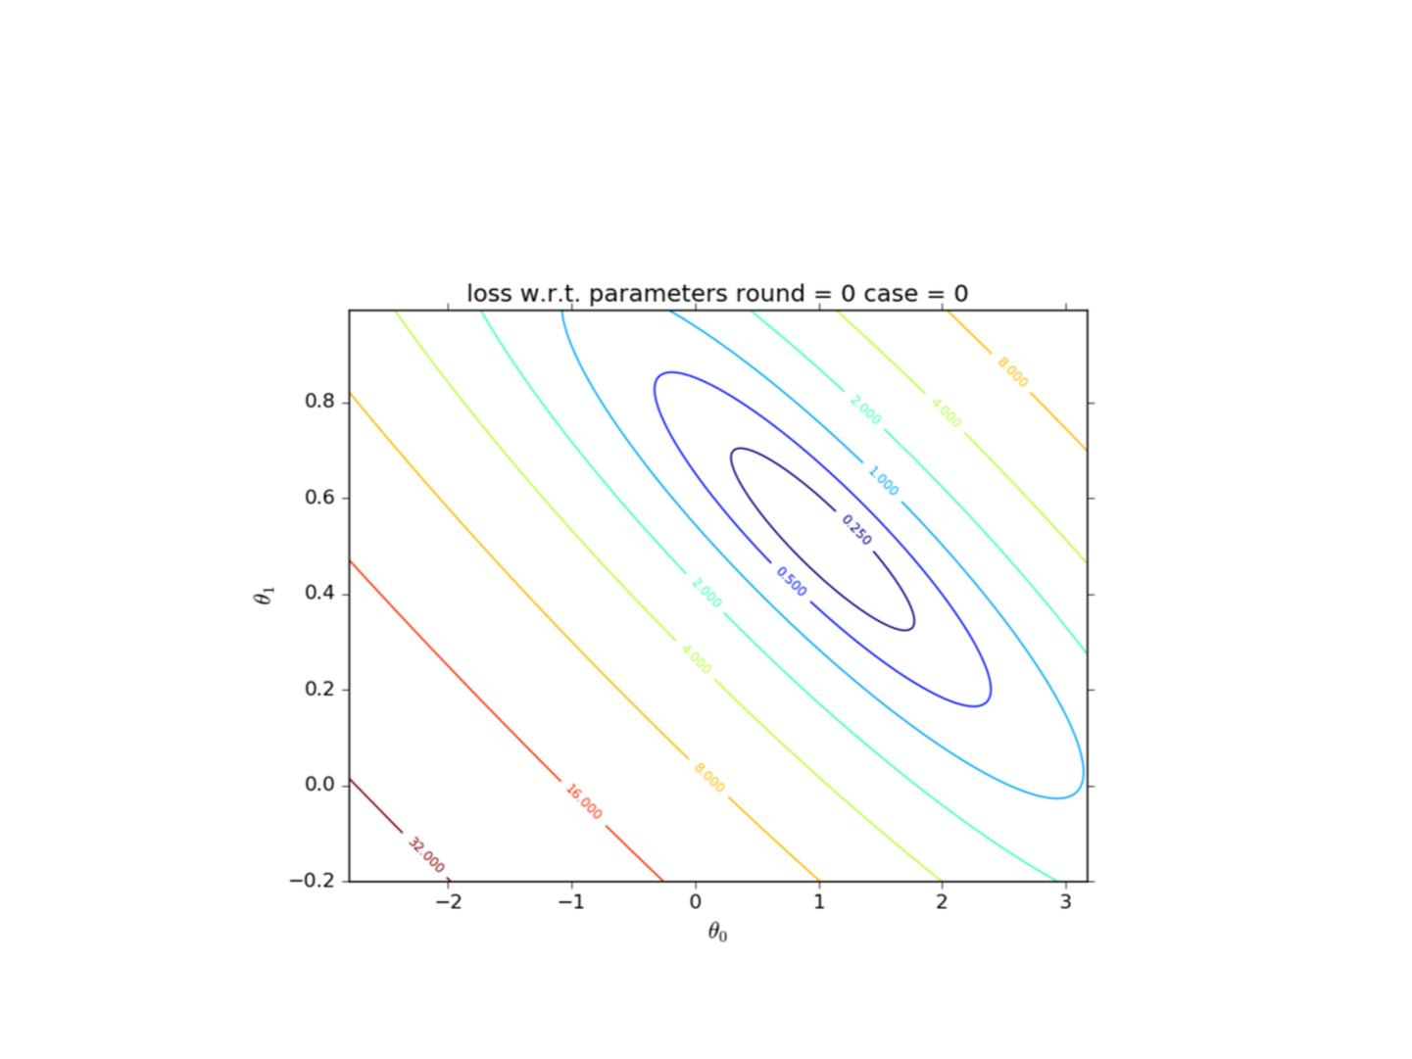
Linear Classification Model

Slide 20
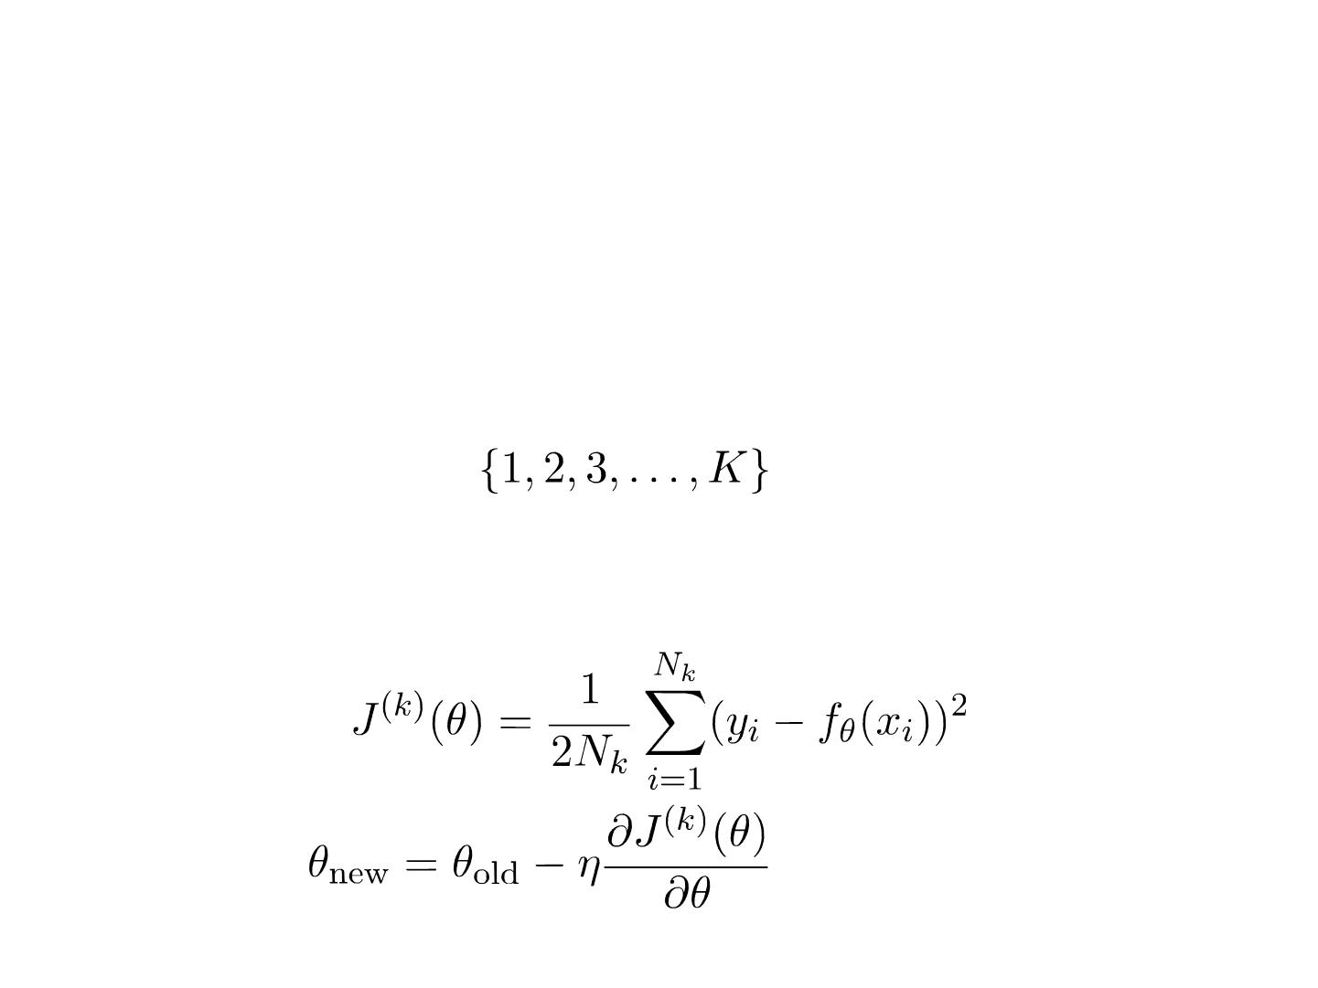
Mini-Batch Gradient Descent
• A combination of batch GD and stochastic GD
• Split the whole dataset into K mini-batches
• For each mini-batch k, perform one-step BGD
toward minimizing
• Update
for each mini-batch

Slide 21
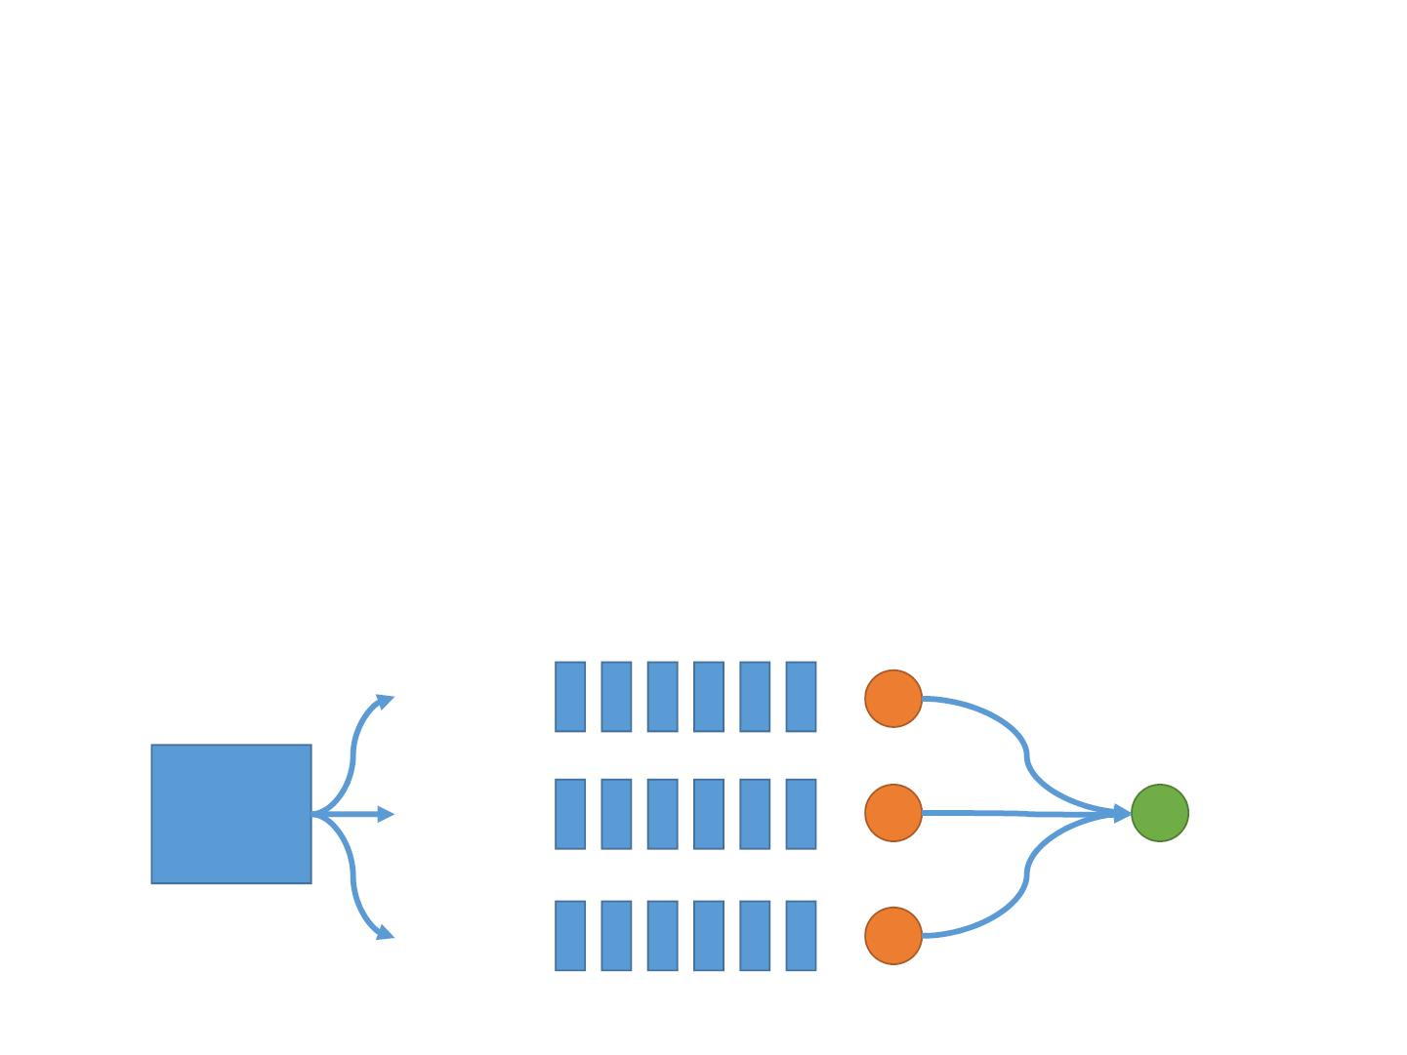
Mini-Batch Gradient Descent
• Good learning stability (BGD)
• Good convergence rate (SGD)
• Easy to be parallelized
• Parallelization within a mini-batch
Map
Parallelized
Gradient Reduce Gradient
Sum
Worker 1
Worker 2
Mini-
batch
Worker 3

Slide 22
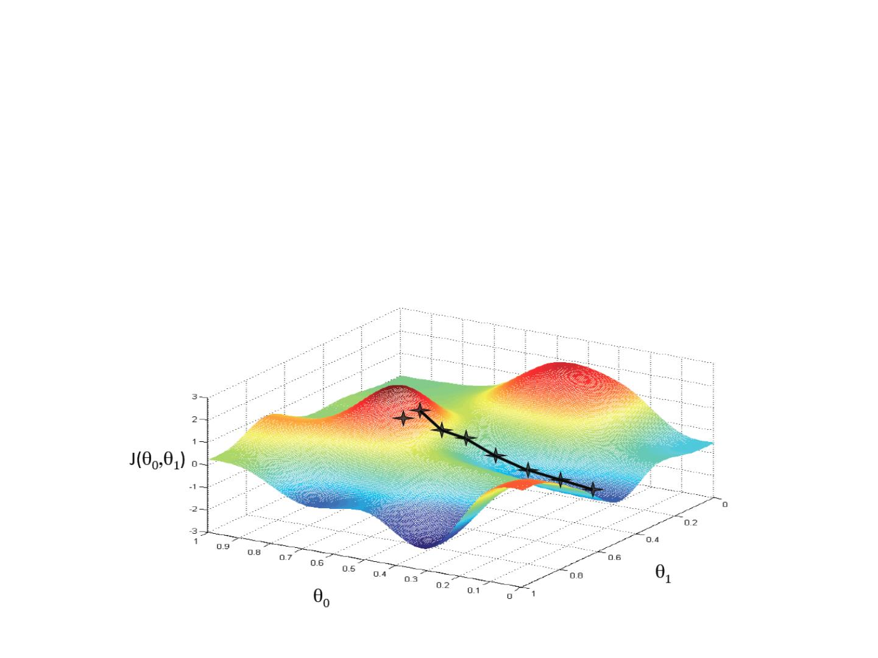
Basic Search Procedure
• Choose an initial value for
⍬
• Update ⍬ iteratively with the data
• Until we research a minimum

Slide 23
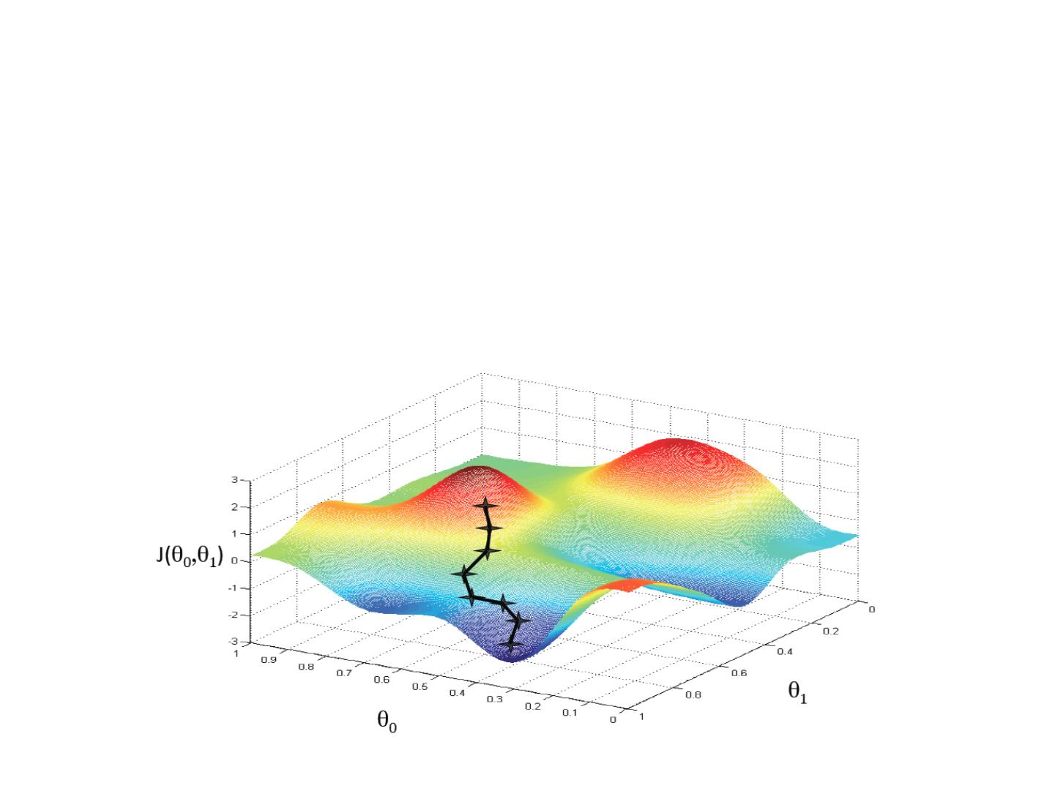
Basic Search Procedure
• Choose a new initial value for
⍬
• Update ⍬ iteratively with the data
• Until we research a minimum

Slide 24
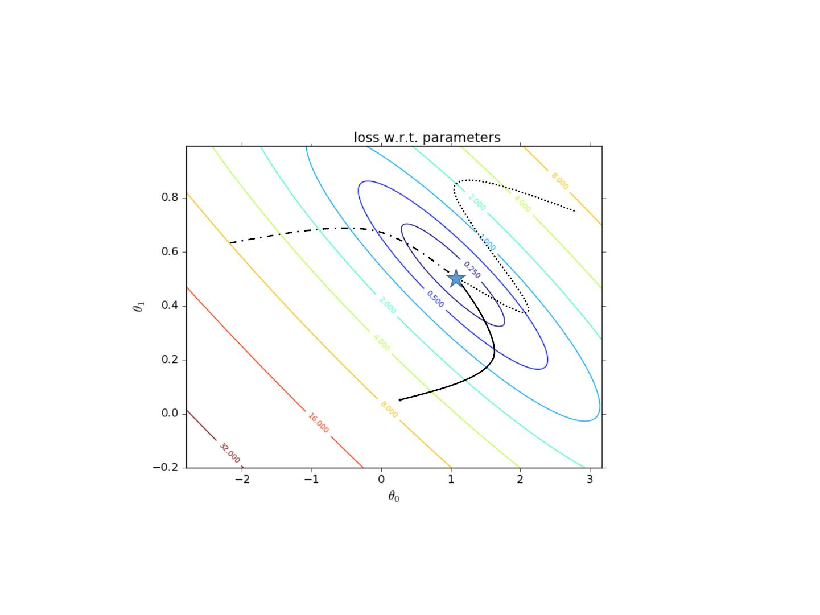
Unique Minimum for Convex Objective
• Different initial parameters and different learning algorithm lead to the
same optimum

Slide 25
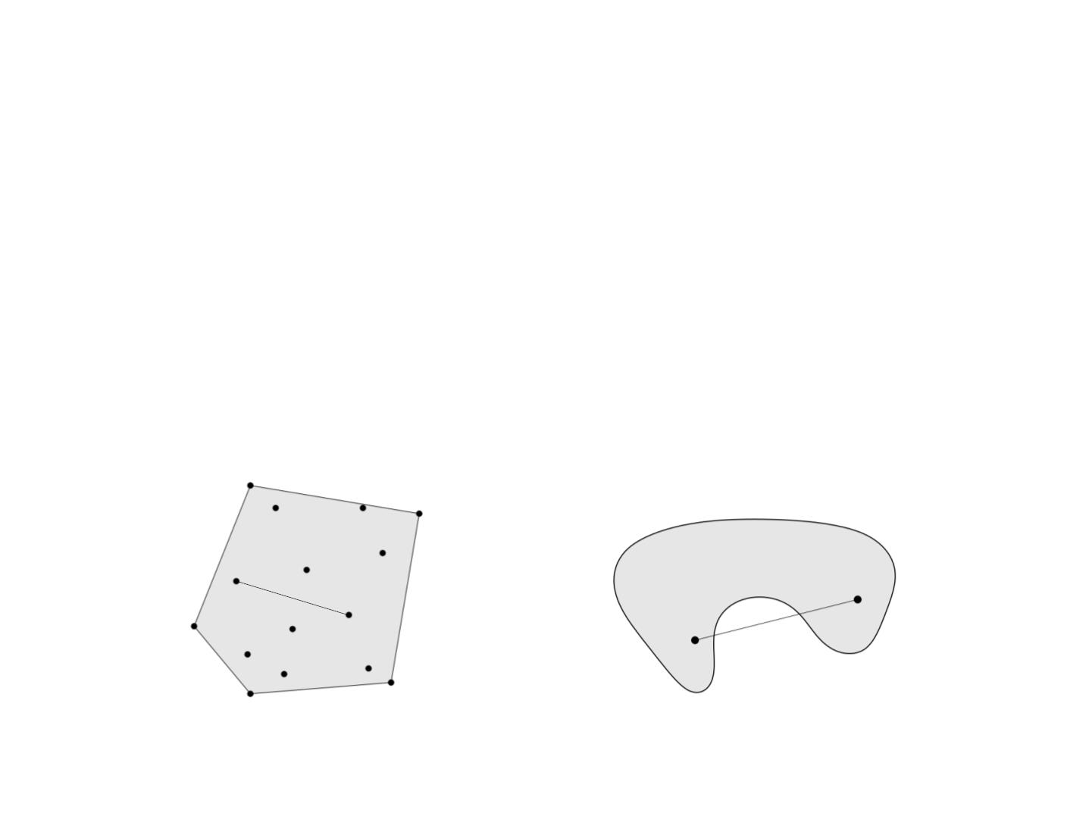


Convex Set
• A convex set S is a set of points such that, given any
two points A, B in that set, the line AB joining them
lies entirely within S.
for all
A
B
B
A
Convex set
Non-convex set
[Boyd, Stephen, and Lieven Vandenberghe. Convex optimization. Cambridge university press, 2004.]

Slide 26
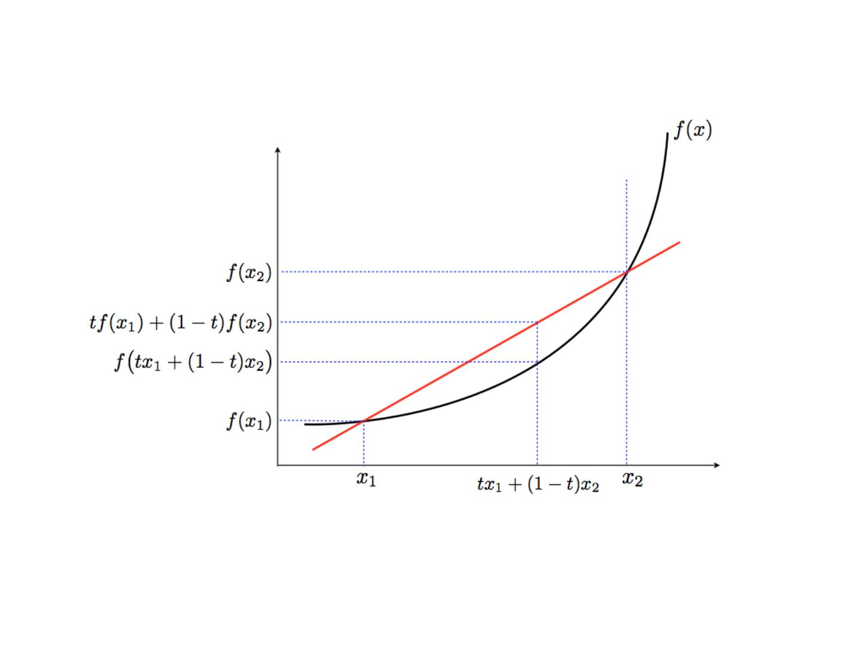



Convex Function
is convex if dom f is a convex set and
for all

Slide 27
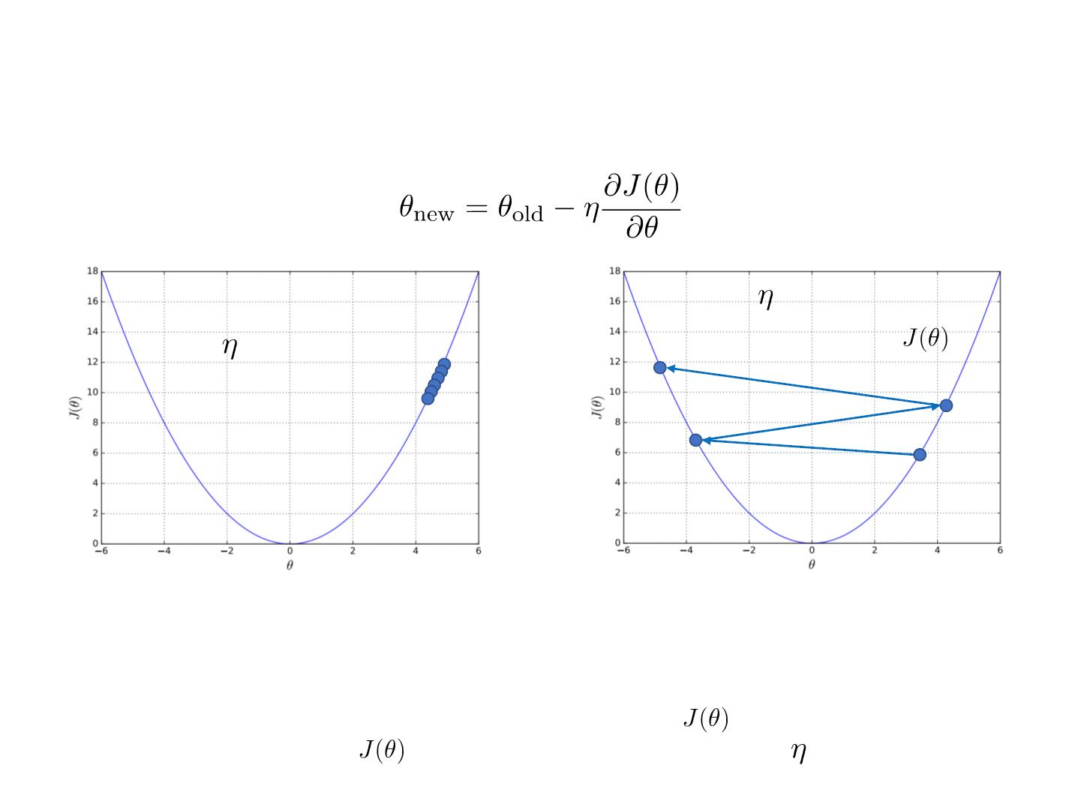
Choosing Learning Rate
too large
too small
Increasing value of
slow convergence
• The initial point may be too far away
from the optimal solution, which
takes much time to converge
• May overshoot the minimum
• May fail to converge
• May even diverge
• To see if gradient descent is working, print out
for each or every
several iterations. If does not drop properly, adjust
Slide credit Eric Eaton

Slide 28
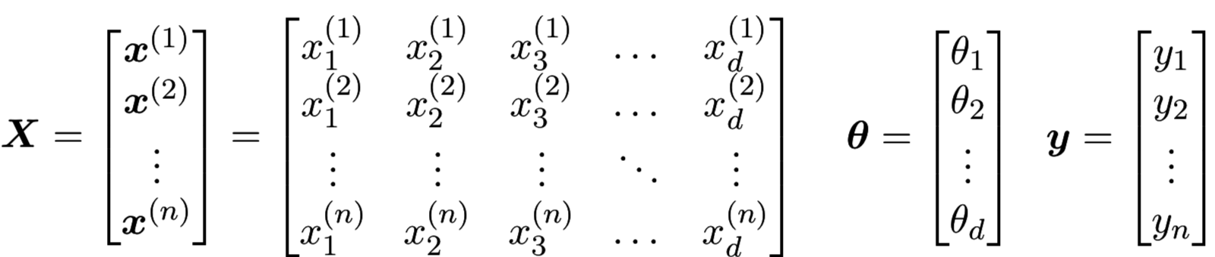
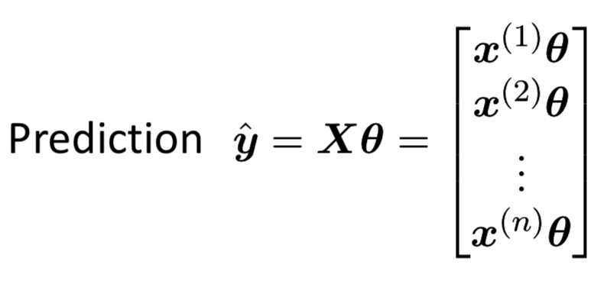
Algebra Perspective

Slide 29
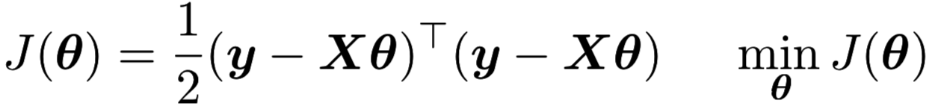
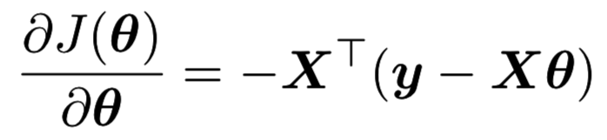
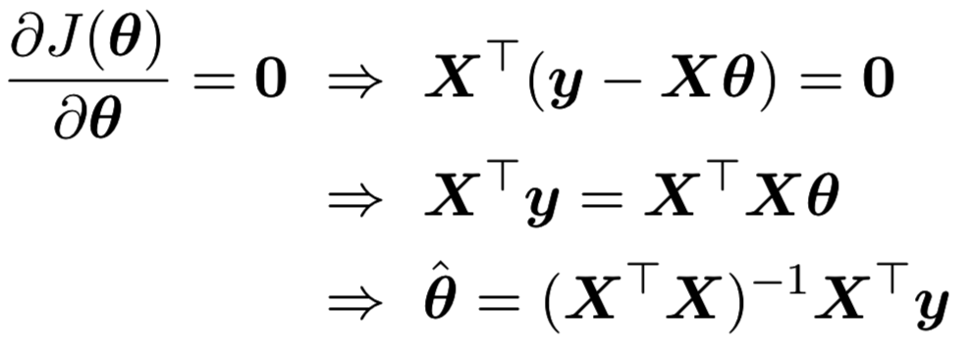
Matrix Form
• Objective
• Gradient
• Solution
http://dsp.ucsd.edu/~kreutz/PEI-05%20Support%20Files/ECE275A_Viewgraphs_5.pdf

Slide 30
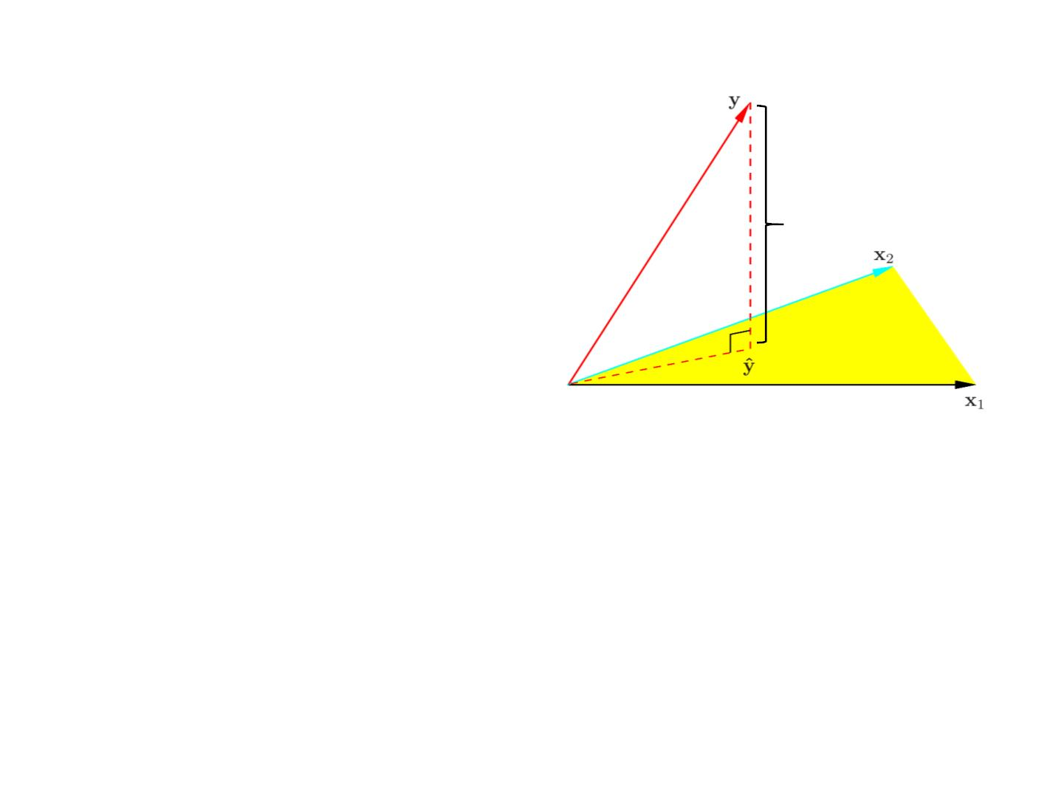

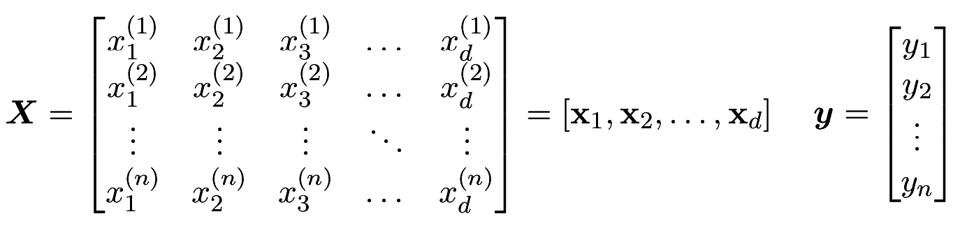
Matrix Form
• Then the predicted values are
Second column
H: hat matrix
• Geometrical Explanation
First column
• The column vectors
[x ; x₂; : : : ; x_{d} ]
form a subspace of
1
• H is a least square projection
More details refer to Sec 3.2. Hastie et al. The elements of statistical learning.

Slide 31
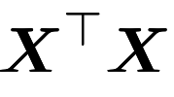
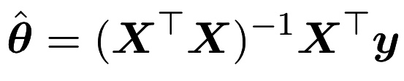
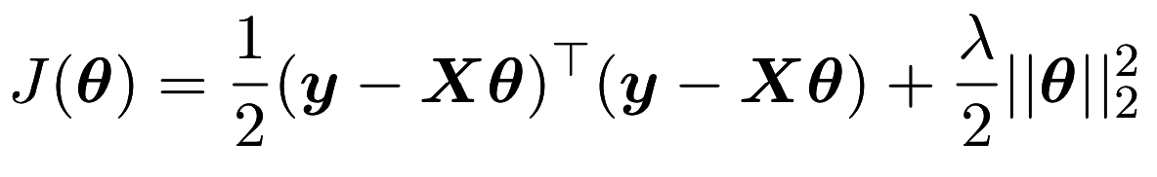
Might be Singular
• When some column vectors are not independent
• For example,
x = 3x
2
1
then is singular, thus
cannot be directly calculated.
• Solution: regularization

Slide 32
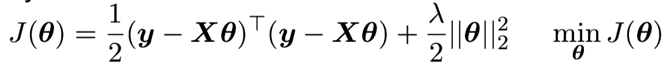
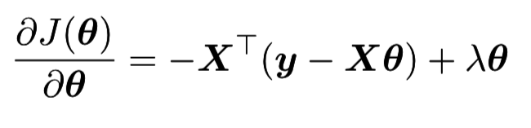
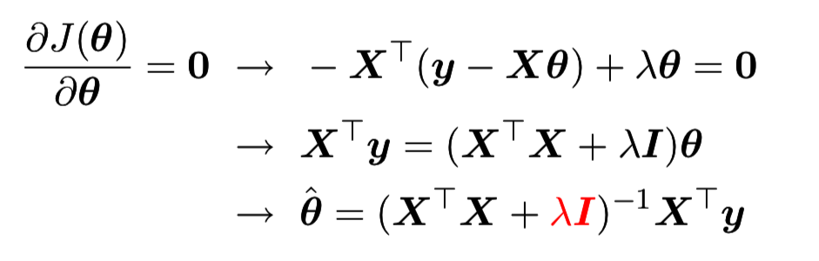
Matrix Form with Regularization
• Objective
• Gradient
• Solution

Slide 33
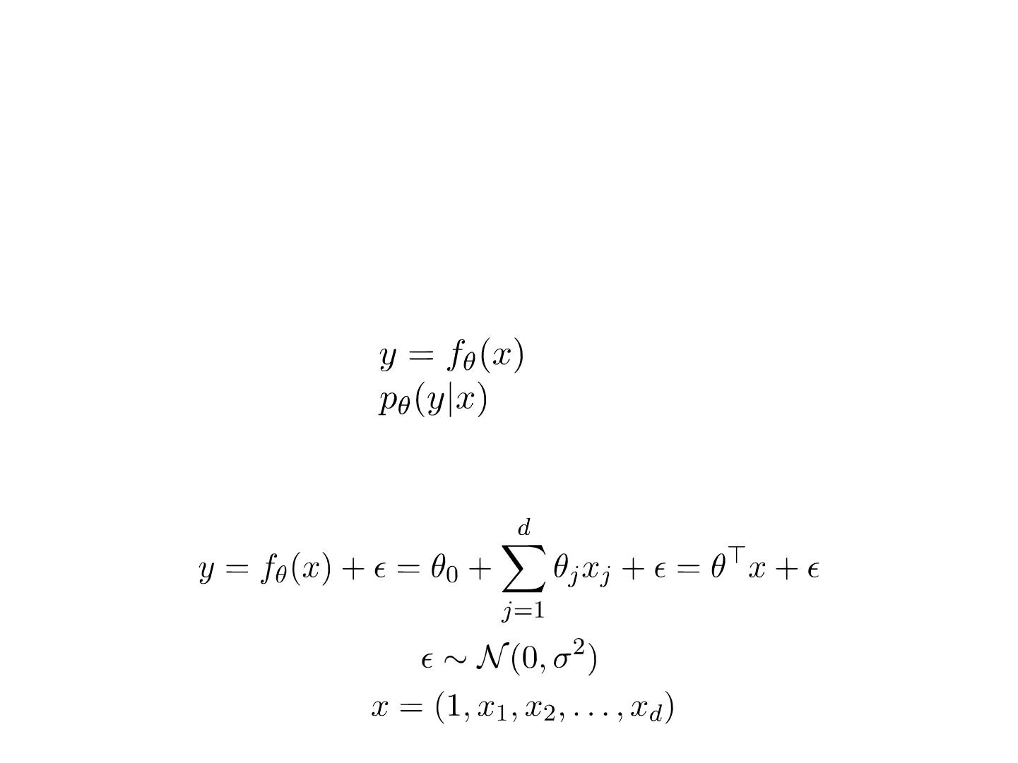
Linear Discriminative Models
• Discriminative model
• modeling the dependence of unobserved variables on
observed ones
• also called conditional models.
• Deterministic:
• Probabilistic:
• Linear regression with Gaussian noise model

Slide 34
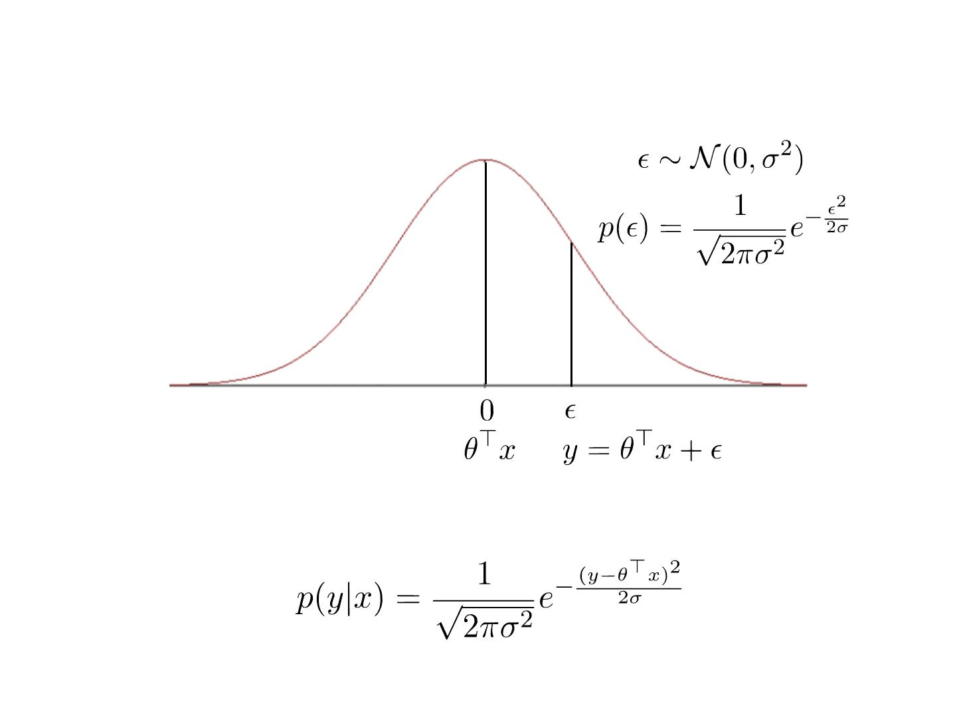
Objective: Likelihood
• Data likelihood

Slide 35
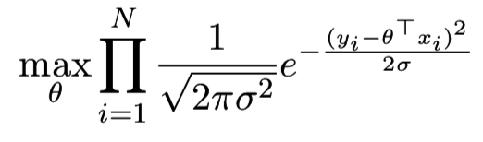
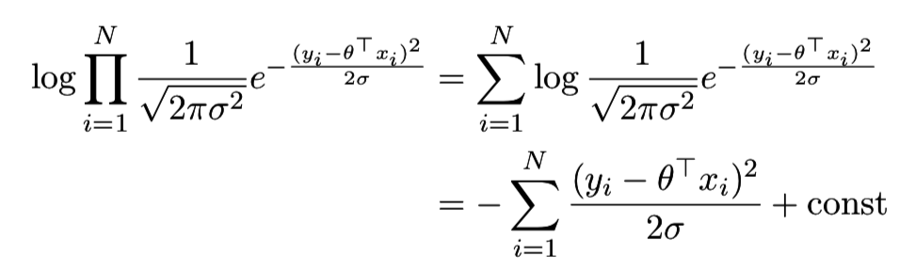
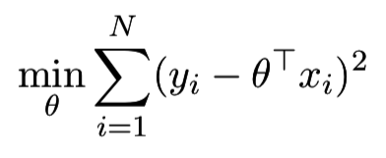
Learning
• Maximize the data likelihood
• Maximize the data log-likelihood
Equivalent to least square error learning

Slide 36
Linear Classification

Slide 37






Classification Problem
• Given:
• A description of an instance,
, where is the
instance space.
• A fixed set of categories:
• Determine:
• The category of x:
, where is a
categorization function whose domain is X and whose
range is C
• If the category set binary, i.e.
({false, true},
{negative, positive}) then it is called binary classification.

Slide 38
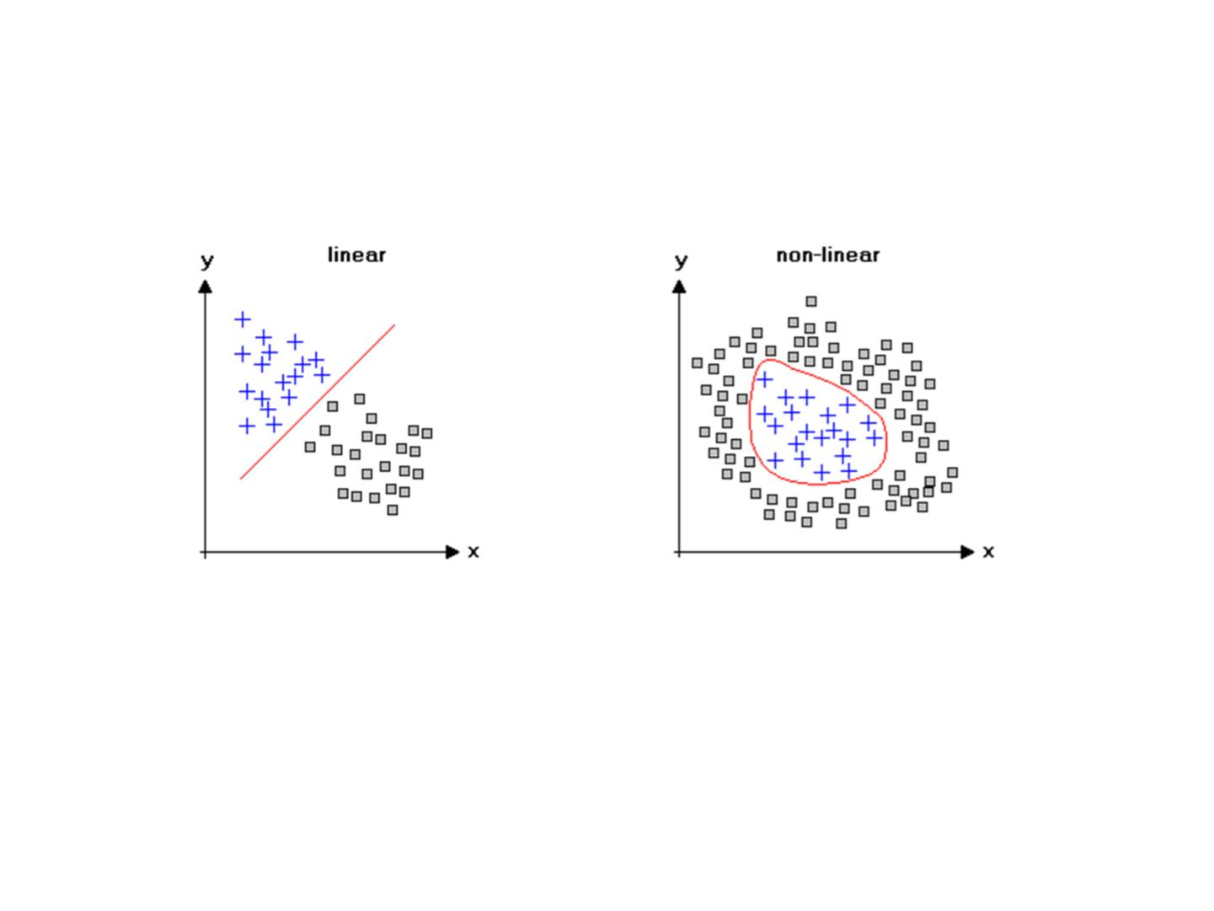
Binary Classification
Linearly inseparable
Non-linearly inseparable

Slide 39


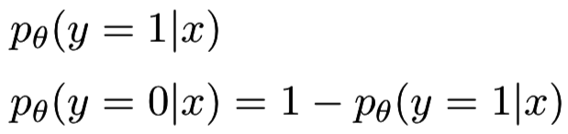
Linear Discriminative Models
• Discriminative model
• modeling the dependence of unobserved
variables on observed ones
• also called conditional models.
• Deterministic:
• Non-differentiable
• Probabilistic:
• Differentiable
• For binary classification

Slide 40


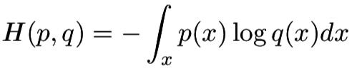
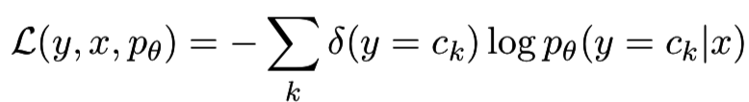
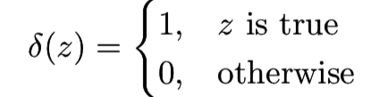
Loss Function
• Cross entropy loss
Discrete case:
Continuous case:
• For classification problem
0
1
0
0
0
Ground Truth
Prediction
0.1
0.6
0.05
0.05
0.2

Slide 41

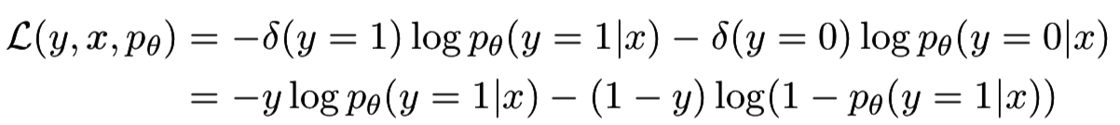
Cross Entropy for Binary Classification
Class 1 Class 2
Ground Truth
Prediction
0
1
0.3
0.7
• Loss function

Slide 42
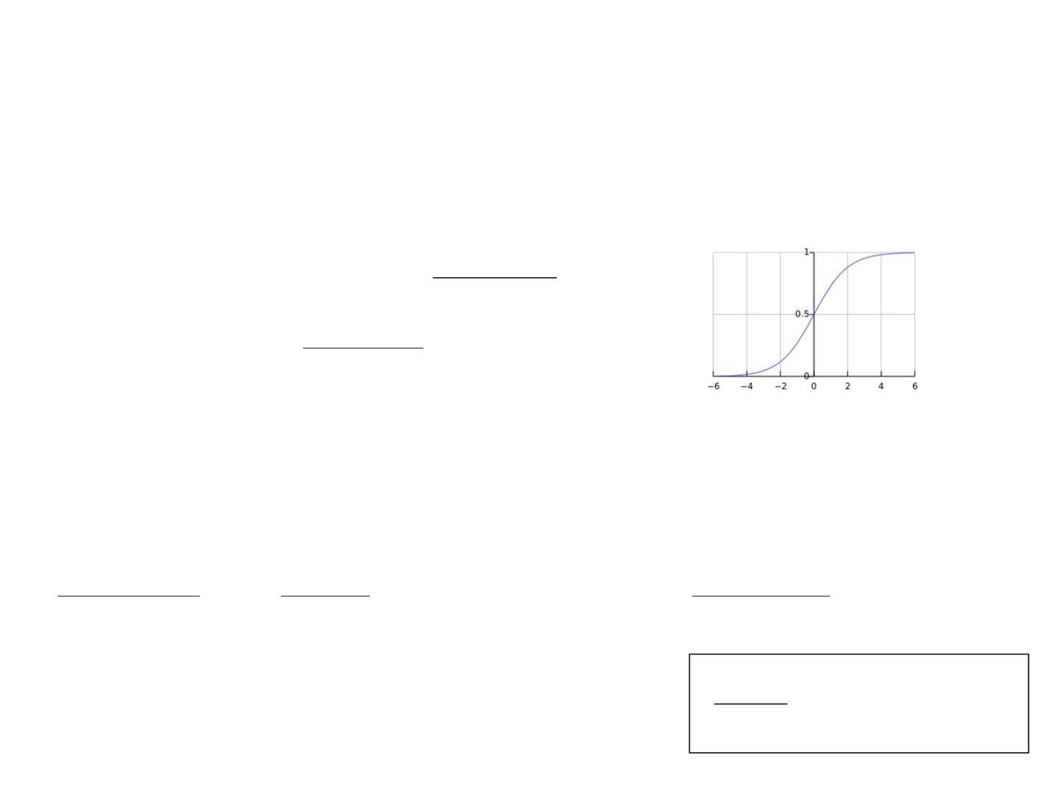
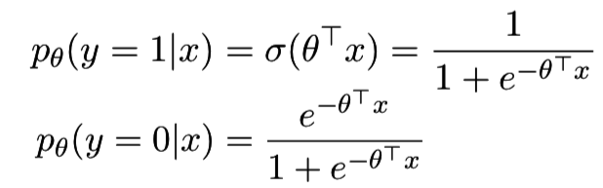



Logistic Regression
• Logistic regression is a binary classification model
x
• Cross entropy loss function
• Gradient

Slide 43



Label Decision
• Logistic regression provides the probability
• The final label of an instance is decided by setting a
threshold
h

Slide 44

Evaluation Measures
Prediction
1
0
True
1
False
Negative
Positive
Label
0
False
Positive
True
Negative
• True / False
Class 1
TP: if predicting 1
FN: if predicting 0
• True: prediction = label
• False: prediction ≠ label
• Positive / Negative
• Positive: predict y = 1
• Negative: predict y = 0
Class 0
FP: if predicting 1
TN: if predicting 0

Slide 45


Evaluation Measures
Prediction
1
0
1
Label
0
• Accuracy: the ratio of cases when prediction = label
TP + TN
Acc =
TP + TN + FP + FN

Slide 46



Evaluation Measures
Prediction
Prediction
1
0
1
0
1
0
False
Negative
1
0
Label
Label
True
Negative
False
Positive
True
Negative
• Precision: the ratio of true
class 1 cases in those with
prediction 1
• Recall: the ratio of cases
with prediction 1 in all true
class 1 cases
TP
Prec =
TP
Rec =
TP + FP
TP + FN

Slide 47



Evaluation Measures
• Precision-recall tradeoff
• Higher threshold, higher
precision, lower recall
• Extreme case: threshold = 0.99
• Lower threshold, lower
precision, higher recall
• Extreme case: threshold = 0
• F1 Measure

Slide 48

Evaluation Measures
• Ranking-based measure: Area Under ROC Curve (AUC)

Slide 49

Evaluation Measures
• Ranking-based measure: Area Under ROC Curve (AUC)
Perfect
Prediction
AUC = 1
Random
Prediction
AUC = 0.5

Slide 50

Evaluation Measures
• A simple example of Area Under ROC Curve (AUC)
Prediction
Label
1.0
0.91
0.85
0.77
0.72
0.61
0.48
0.42
0.33
1
0
1
1
0
1
0
0
0.75
0.5
True
Positive
Ratio
0.25
0.25
0.5
0.75
1.0
False Positive Ratio
AUC = 0.75

Slide 51


Multi-Class Classification
• Still cross entropy loss
Ground Truth
0
1
0
Prediction
0.1
0.7
0.2

Slide 52



Multi-Class Logistic Regression
• Class set
• Predicting the probability of
• Softmax
• Parameters
• Can be normalized with m-1 groups of parameters

Slide 53



Multi-Class Logistic Regression
• Learning on one instance
• Maximize log-likelihood
• Gradient
=

Slide 54
Application Case Study
Click-Through Rate (CTR) Estimation in Online Advertising

Slide 55

Ad Click-Through Rate Estimation
Click or not?
[http://news.ifeng.com]

Slide 56

User response estimation problem
• Problem definition
One instance data
Corresponding label
• Date: 20160320
• Hour: 14
• Weekday: 7
• IP: 119.163.222.*
• Region: England
• City: London
• Country: UK
• Ad Exchange: Google
• Domain: yahoo.co.uk
• URL: http://www.yahoo.co.uk/abc/xyz.html
• OS: Windows
Click (1) or not (0)?
Predicted CTR (0.15)
• Browser: Chrome
• Ad size: 300*250
• Ad ID: a1890
• User occupation: Student
• User tags: Sports, Electronics

Slide 57

One-Hot Binary Encoding
• A standard feature engineering paradigm
x=[Weekday=Friday, Gender=Male, City=Macau]
x=[0,0,0,0,1,0,0 0,1 0,0,1,0…0]
Sparse representation: x=[5:1 9:1 12:1]
• High dimensional sparse binary feature vector
• Usually higher than 1M dimensions, even 1B dimensions
• Extremely sparse

Slide 58
Training /Validation/Test Data
• Examples (in LibSVM format)
1 5:1 9:1 12:1 45:1 154:1 509:1 4089:1 45314:1 988576:1
0 2:1 7:1 18:1 34:1 176:1 510:1 3879:1 71310:1 818034:1
…
• Training /Validation/Test data split
• Sort data by time
• Train:validation:test = 8:1:1
• Shuffle training data

Slide 59



Training Logistic Regression
• Logistic regression is a binary classification model
• Cross entropy loss function with L2 regularization
• Parameter learning
• Only update non-zero entries

Slide 60
Generalized Linear
Models

Slide 61

Review: Linear Regression

Slide 62



Review: Matrix Form of Linear Reg.
• Objective
• Gradient
• Solution

Slide 63




Generalized Linear Models
• Dependence
• Feature mapping function
• Mapped feature matrix

Slide 64



Matrix Form of Kernel Linear Regression
• Objective
• Gradient
• Solution

Slide 65




Matrix Form of Kernel Linear Regression
• With the Algebra trick
• The optimal parameters with L2 regularization
for prediction, we never actually need access
$$Φ$$
where the kernel matrix
[http://www.ics.uci.edu/~welling/classnotes/papers_class/Kernel-Ridge.pdf]

